Slide 1
Chapter 9
Organizational Structure and Design
Chapter 9, Stephen P. Robbins, Mary Coulter, and Nancy Langton, Management, Ninth Canadian Edition
Copyright © 2009 Pearson Education Canada
9-<number>

Slide 2
What Is an Organization?
Recall from Ch. 1: An Organization Defined
A deliberate arrangement of people who act together to accomplish some specific purpose
Chapter 1, Stephen P. Robbins, Mary Coulter, and Nancy Langton, Management, Ninth Canadian Edition
Copyright © 2009 Pearson Education Canada
1-<number>
Notes:
Learning Objective #3
Organizations need managers. An organization is a deliberate arrangement of people to accomplish some specific purpose.
A. Organizations share three common characteristics:
(1) each has a distinct purpose;
(2) each is composed of people; and
(3) each develops some deliberate structure so members can do their work (see Exhibit 1.7).

Slide 3
The Result is: Organizational Structure
Organizational Structure
  The formal arrangement of jobs within an organization
Achieved through Organizational Design
  A process involving decisions about six key elements:
    Work specialization
    Departmentalization
    Chain of command
    Span of control
    Centralization and decentralization
    Formalization
Chapter 9, Stephen P. Robbins, Mary Coulter, and Nancy Langton, Management, Ninth Canadian Edition
Copyright © 2009 Pearson Education Canada
9-<number>
Notes:
Learning Objective #1
Organizational structure can play an important role in an organization’s success. The process of organizing—the second management function—is how an organization’s structure is created.
Managers seek structural designs that will best support and allow employees to effectively and efficiently do their work.
A. Before we look at the elements of organizational structure and design, we need to define some important terms.
1. Organizing is the process of creating an organization’s structure. That process has several purposes, as shown in Exhibit 9.1.
2. An organizational structure is the formal arrangement of jobs within an organization.
3. Organizational design is the process of developing or changing an organization’s structure. It involves decisions about six key elements: work specialization, departmentalization, chain of command, span of control, centralization/decentralization, and formalization. We need to take a closer look at each of these structural elements.

Slide 4
  The Six Elements of Organizational Structure
1-<number>

Slide 5
Work Specialization
The degree to which tasks in the organization are divided into separate jobs with each step completed by a different person
    Overspecialization can result in human diseconomies from boredom, fatigue, stress, poor quality, increased absenteeism, and higher turnover
Chapter 9, Stephen P. Robbins, Mary Coulter, and Nancy Langton, Management, Ninth Canadian Edition
Copyright © 2009 Pearson Education Canada
9-<number>
Notes:
Work specialization is the degree to which tasks in an organization are divided into separate jobs. Most managers today see work specialization as an important organizing mechanism but not as a source of ever-increasing productivity.

Slide 6
Departmentalization by Type
Functional
  Grouping jobs by functions performed
Product
  Grouping jobs by product line
Geographical
  Grouping jobs on the basis of territory or geography
Process
  Grouping jobs on the basis of product or customer flow
Customer
  Grouping jobs by type of customer and needs
Chapter 9, Stephen P. Robbins, Mary Coulter, and Nancy Langton, Management, Ninth Canadian Edition
Copyright © 2009 Pearson Education Canada
9-<number>
Notes:
Departmentalization. Once work tasks have been defined, they must be grouped together in some way through a process called departmentalization—the basis on which jobs are grouped in order to accomplish organizational goals. There are five major ways to departmentalize (Exhibit 9.2):
1. Functional departmentalization is grouping jobs by functions performed.
2. Product departmentalization is grouping jobs by product line.
3. Geographical departmentalization is grouping jobs on the basis of territory or geography.
4. Process departmentalization is grouping jobs on the basis of product or customer flow.
5. Customer departmentalization is grouping jobs on the basis of common customers.
6. Two popular trends in departmentalization include:
a. Customer departmentalization continues to be a highly popular approach because it allows better monitoring of customers’ needs and responding to those changes in needs.
b. Cross-functional teams, a hybrid grouping of individuals who are experts in various specialties (or functions) and who work together, are being used along with traditional departmental arrangements.

Slide 7
Chain of Command
  The continuous line of authority that extends from upper levels of an organization to the lowest levels of the organization and clarifies who reports to whom
Chapter 9, Stephen P. Robbins, Mary Coulter, and Nancy Langton, Management, Ninth Canadian Edition
Copyright © 2009 Pearson Education Canada
9-<number>
Notes:
The chain of command is the continuous line of authority that extends from the upper organizational levels to the lowest levels and clarifies who reports to whom. Three related concepts include authority, responsibility, and unity of command.

Slide 8
Chain of Command Concepts
Authority
  The rights inherent in a managerial position to tell people what to do and to expect them to do it
Responsibility
  The obligation or expectation to perform. Responsibility brings with it accountability (the need to report and justify work to manager’s superiors)
Unity of Command
  The concept that a person should have one boss and should report only to that person
Delegation
  The assignment of authority to another person to carry out specific duties
9-<number>
Chapter 9, Stephen P. Robbins, Mary Coulter, and Nancy Langton, Management, Ninth Canadian Edition
Copyright © 2009 Pearson Education Canada
Notes:
1. Authority is the right inherent in a managerial position to tell people what to do and to expect them to do it.
2. Responsibility is the obligation or expectation to perform. Responsibility brings with it accountability, which is the need to report and justify work to a manager’s superiors.
3. Unity of command is the classical management principle that a subordinate should have one and only one superior to whom he or she is directly responsible; that is, a person should report to only one manager.
a. Because managers have limited time and knowledge, they may choose to delegate some of their responsibilities to other employees. Delegation is the assignment of authority to another person to carry out specific duties, allowing employees to make some of the decisions.

Slide 9
Line vs Staff Management
  Line managers are responsible for the essential activities of the organization, including production and sales. Line managers have the authority to issue orders to those in the chain of command
    The president, the production manager, and the sales manager are examples of line managers
  Staff managers have advisory authority, and cannot issue orders to those in the chain of command (except those in their own department)
9-<number>
Chapter 9, Stephen P. Robbins, Mary Coulter, and Nancy Langton, Management, Ninth Canadian Edition
Copyright © 2009 Pearson Education Canada
Notes:
a. Line managers are responsible for the essential activities of the organization, including production and sales.
b. Staff managers have advisory authority, and cannot issue orders to those in the chain of command, except for those in their own department.

Slide 10
Span of Control
  The number of employees who can be effectively and efficiently supervised by a manager
  Width of span is affected by:
    Skills and abilities of the manager and the employees
    Characteristics of the work being done
    Similarity of tasks
    Complexity of tasks
    Physical proximity of subordinates
    Standardization of tasks
    Sophistication of the organization’s information system
    Strength of the organization’s culture
    Preferred style of the manager
Chapter 9, Stephen P. Robbins, Mary Coulter, and Nancy Langton, Management, Ninth Canadian Edition
Copyright © 2009 Pearson Education Canada
9-<number>
Notes:
The concept of span of control refers to the number of subordinates a manager can supervise effectively and efficiently.
1. The span of control concept is important because it determines how many levels and managers an organization will have (see Exhibit 9.3 for an example).
2. What determines the “ideal” span of control? Contingency factors such as the skills and abilities of the manager and the employees, the characteristics of the work being done, similarity of employee tasks, the complexity of those tasks, the physical proximity of subordinates, the degree to which standardized procedures are in place, the sophistication of the organization’s information system, the strength of the organization’s culture, and the preferred style of the manager will influence the ideal number of subordinates.
3. The trend in recent years has been toward larger spans of control.

Slide 11
Exhibit 9.3 Contrasting Spans of Control
Members at Each Level
(Highest)
Assuming Span of 4
Assuming Span of 8
1
1
1
Organizational Level
2
4
8
3
16
64
4
64
512
5
256
4096
6
1024
7
4096
(Lowest)
Span of 4:
Span of 8:
Employees:
= 4096
Employees:
= 4096
Managers (level 1–6)
= 1365
Managers (level 1–4)
= 585
Chapter 9, Stephen P. Robbins, Mary Coulter, and Nancy Langton, Management, Ninth Canadian Edition
Copyright © 2009 Pearson Education Canada
9-<number>
Notes:
As Exhibit 9.3 shows, if one organization has a uniform span of four and the other a span of eight, the wider span will have two fewer levels and approximately 800 fewer managers. If the average manager made $42 000 a year, the organization with the wider span would save over $33 million a year in management salaries alone!

Slide 12
Centralization vs Decentralization
Centralization
  The degree to which decision making is concentrated at a single point in the organization
    Organizations in which top managers make all the decisions and lower-level employees simply carry out those orders
Decentralization
  The degree to which lower-level employees provide input or actually make decisions
  Employee Empowerment
    Increasing the decision-making discretion of employees
Chapter 9, Stephen P. Robbins, Mary Coulter, and Nancy Langton, Management, Ninth Canadian Edition
Copyright © 2009 Pearson Education Canada
9-<number>
Notes:
The concepts of centralization and decentralization address who, where, and how decisions are made in organizations.
1. Centralization is the degree to which decision making is concentrated at a single point in the organization, usually in the upper levels of the organization.
2. Decentralization is the handing down of decision-making authority to lower levels in an organization.
3. The trend is toward decentralizing decision making in order to make organizations more flexible and responsive.
4. Employee empowerment is another term for increased decentralization and is the increasing of the decision-making discretion of employees.
5. A number of factors will influence the amount of centralization or decentralization an organization uses (see Exhibit 9.4).

Slide 13
Figure 9.4 Factors that Influence the Amount of Centralization
More Centralization
  Environment is stable
  Lower-level managers are not as capable or experienced at making decisions as upper-level managers
  Lower-level managers do not want to have a say in decisions
  Decisions are significant
  Organization is facing a crisis or the risk of company failure
  Company is large
  Effective implementation of company strategies depends on managers retaining say over what happens
Chapter 9, Stephen P. Robbins, Mary Coulter, and Nancy Langton, Management, Ninth Canadian Edition
Copyright © 2009 Pearson Education Canada
9-<number>

Slide 14
Figure 9.4 Factors that Influence the Amount of Decentralization
More Decentralization
  Environment is complex, uncertain
  Lower-level managers are capable and experienced at making decisions
  Lower-level managers want a voice in decisions
  Decisions are relatively minor
  Corporate culture is open to allowing managers to have a say in what happens
  Company is geographically dispersed
  Effective implementation of company strategies depends on managers having involvement and flexibility to make decisions
Chapter 9, Stephen P. Robbins, Mary Coulter, and Nancy Langton, Management, Ninth Canadian Edition
Copyright © 2009 Pearson Education Canada
9-<number>

Slide 15
Formalization
  The degree to which jobs within the organization are standardized and the extent to which employee behaviour is guided by rules and procedures
    Highly formalized jobs offer little discretion over what is to be done
    Low formalization means fewer constraints on how employees do their work
Chapter 9, Stephen P. Robbins, Mary Coulter, and Nancy Langton, Management, Ninth Canadian Edition
Copyright © 2009 Pearson Education Canada
9-<number>
Notes:
Formalization refers to the degree to which jobs within an organization are standardized and the extent to which employee behaviour is guided by rules and procedures.
1. In a highly formalized organization, employees have little discretion, and there’s a high level of consistent and uniform output. Formalized organizations have explicit job descriptions, lots of organizational rules, and clearly defined procedures.
2. In a less-formalized organization, employees have a lot of freedom and can exercise discretion in the way they do their work.
3. Standardization not only eliminates the possibility that employees will engage in alternative behaviours, it even removes the need for employees to consider alternatives.
4. The degree of formalization can vary widely between organizations and even within organizations.

Slide 16
  Organizational Design Decisions
1-<number>

Slide 17
Organizational Design Decisions
Mechanistic Organization
  A rigid and tightly controlled structure
    High specialization
    Rigid departmentalization
    Narrow spans of control
    High formalization
    Limited information network (mostly downward communication)
    Low decision participation by lower-level employees
Organic Organization
  Highly flexible and adaptable structure
    Non-standardized jobs
    Fluid team-based structure
    Little direct supervision
    Minimal formal rules
    Open communication network
    Empowered employees
Chapter 9, Stephen P. Robbins, Mary Coulter, and Nancy Langton, Management, Ninth Canadian Edition
Copyright © 2009 Pearson Education Canada
9-<number>
Notes:
Learning Objective #2
Organizations don’t have the same structures. Even companies of similar size do not necessarily have similar structures.
A. Mechanistic and Organic organizational forms (see Exhibit 9.5).
1) A mechanistic organization is an organizational structure that’s characterized by high specialization, rigid departmentalization, narrow spans of control, high formalization, a limited information network, and little participation in decision making by low-level employees.
2) An organic organization is a structure that’s highly adaptive and flexible with little work specialization, minimal formalization, and little direct supervision of employees.
3) When is each design favoured? It “depends” on the contingency variables.

Slide 18
Mechanistic Vs Organic Organization
Mechanistic
Organic
•
High Specialization
•
Cross-Functional Teams
Rigid Departmentalization
•
•
Cross-Hierarchical Teams
•
Clear Chain of Command
Free Flow of Information
•
•
Narrow Spans of Control
•
Wide Spans of Control
•
Centralization
•
Decentralization
•
High Formalization
•
Low Formalization
Chapter 9, Stephen P. Robbins, Mary Coulter, and Nancy Langton, Management, Ninth Canadian Edition
Copyright © 2009 Pearson Education Canada
9-<number>
Notes:
Mechanistic and Organic organizational forms (see Exhibit 9.5).

Slide 19
Structural Contingency Factors
Structural decisions are influenced by:
  Overall strategy of the organization
    Organizational structure follows strategy
  Size of the organization
    Firms change from organic to mechanistic organizations as they grow in size
  Technology use by the organization
    Firms adapt their structure to the technology they use
  Degree of environmental uncertainty
    Dynamic environments require organic structures; mechanistic structures need stable environments
9-<number>
Chapter 9, Stephen P. Robbins, Mary Coulter, and Nancy Langton, Management, Ninth Canadian Edition
Copyright © 2009 Pearson Education Canada
Notes:
Contingency factors—appropriate structure depends on four contingency variables:
1. Strategy and Structure. One of the contingency variables that influences organizational design is the organization’s strategy.
2. Size and Structure. There’s considerable historical evidence that an organization’s size significantly affects its structure. Larger organizations tend to have more specialization, departmentalization, centralization, and formalization although the size-structure relationship is not linear.
3. Technology also has been shown to affect an organization’s choice of structure. Every organization uses some form of technology to transform inputs into outputs.

Slide 20
Strategy and Structure
  Achievement of strategic goals is facilitated by changes in organizational structure that accommodate and support change
Chapter 9, Stephen P. Robbins, Mary Coulter, and Nancy Langton, Management, Ninth Canadian Edition
Copyright © 2009 Pearson Education Canada
9-<number>
Notes:
1. Strategy and Structure. One of the contingency variables that influences organizational design is the organization’s strategy.
a. Most current strategy-structure frameworks tend to focus on three strategy dimensions:
1) Innovation—needs the flexibility and free flow of information of the organic organization
2) Cost minimization—needs the efficiency, stability, and tight controls of the mechanistic organization
3) Imitation—which uses characteristics of both mechanistic and organic
2. Size and Structure. There’s considerable historical evidence that an organization’s size significantly affects its structure. Larger organizations tend to have more specialization, departmentalization, centralization, and formalization although the size-structure relationship is not linear.

Slide 21
Different Strategy Frameworks
  Innovation
    Pursuing competitive advantage through meaningful and unique innovations favouring organic structuring
  Cost minimization
    Focusing on tightly controlling costs requires a mechanistic structure for the organization
  Imitation
    Minimizing risks and maximizing profitability by copying market leaders requires both organic and mechanistic elements in the organization’s structure
9-<number>
Chapter 9, Stephen P. Robbins, Mary Coulter, and Nancy Langton, Management, Ninth Canadian Edition
Copyright © 2009 Pearson Education Canada

Slide 22
Size and Structure
  As an organization grows larger, its structure tends to change from organic to mechanistic with increased specialization, departmentalization, centralization, and rules and regulations
Chapter 9, Stephen P. Robbins, Mary Coulter, and Nancy Langton, Management, Ninth Canadian Edition
Copyright © 2009 Pearson Education Canada
9-<number>
Notes:
1. Strategy and Structure. One of the contingency variables that influences organizational design is the organization’s strategy.
a. Most current strategy-structure frameworks tend to focus on three strategy dimensions:
1) Innovation—needs the flexibility and free flow of information of the organic organization
2) Cost minimization—needs the efficiency, stability, and tight controls of the mechanistic organization
3) Imitation—which uses characteristics of both mechanistic and organic
2. Size and Structure. There’s considerable historical evidence that an organization’s size significantly affects its structure. Larger organizations tend to have more specialization, departmentalization, centralization, and formalization although the size-structure relationship is not linear.

Slide 23
Technology and Structure
  Organizations adapt their structures to their technology
    Routine technology = mechanistic organizations
    Non–routine technology = organic organizations
    Consider Woodward’s work…
Chapter 9, Stephen P. Robbins, Mary Coulter, and Nancy Langton, Management, Ninth Canadian Edition
Copyright © 2009 Pearson Education Canada
9-<number>
Notes:
3. Technology also has been shown to affect an organization’s choice of structure.
a. Every organization uses some form of technology to transform inputs into outputs.
b. Joan Woodward’s study of structure and technology found that organizations adapted to their technology. She found that three distinct technologies had increasing levels of complexity and sophistication.
1) Unit production is the production of items in units or small batches.
2) Mass production is large-batch manufacturing.
3) Process production is continuous-process production.
c. Woodward found in her study of these three groups that distinct relationships existed between these technologies, the subsequent structure of the organization, and the effectiveness of the organization. Exhibit 9.6 provides a summary of these findings.

Slide 24
Environmental Uncertainty and Structure
  Mechanistic organizational structures tend to be most effective in stable and simple environments
  The flexibility of organic organizational structures is better suited for dynamic and complex environments
9-<number>
Chapter 9, Stephen P. Robbins, Mary Coulter, and Nancy Langton, Management, Ninth Canadian Edition
Copyright © 2009 Pearson Education Canada
Notes:
The final contingency factor that has been shown to affect organizational structure is environmental uncertainty. One way to manage environmental uncertainty is through adjustments in the organization’s structure. The more uncertain the environment, the more flexible and responsive the organization may need to be.

Slide 25
  Organizational Structures
1-<number>

Slide 26
Traditional Organizational Designs
Simple Structure
  Low departmentalization, wide spans of control, centralized authority, little formalization
Functional Structure
  Departmentalization by function
    Operations, finance, human resources, and product research and development
Divisional Structure
  Composed of separate business units or divisions with limited autonomy under the coordination and control of the parent corporation
Chapter 9, Stephen P. Robbins, Mary Coulter, and Nancy Langton, Management, Ninth Canadian Edition
Copyright © 2009 Pearson Education Canada
9-<number>
Notes:
Learning Objective #3
We now need to look at various organizational designs that you might see in today’s organizations. Exhibit 9.7 summarizes the strengths and weaknesses of each of these designs.
1. A simple structure is an organizational design with low departmentalization, wide spans of control, authority centralized in a single person, and little formalization.
a. Its strengths are its flexibility, speed, and low cost to maintain.
b. Its major drawback is that it’s most effective in small organizations.
2. As an organization grows, the structure tends to become more specialized and formalized. When contingency factors favour a bureaucratic or mechanistic design, one of two options is likely to be used.
3. One option expands functional departmentalization into the functional structure, which is an organizational design that groups similar or related occupational specialties together.
4. The other option is the divisional structure, which is an organizational structure made up of autonomous, self-contained units.

Slide 27
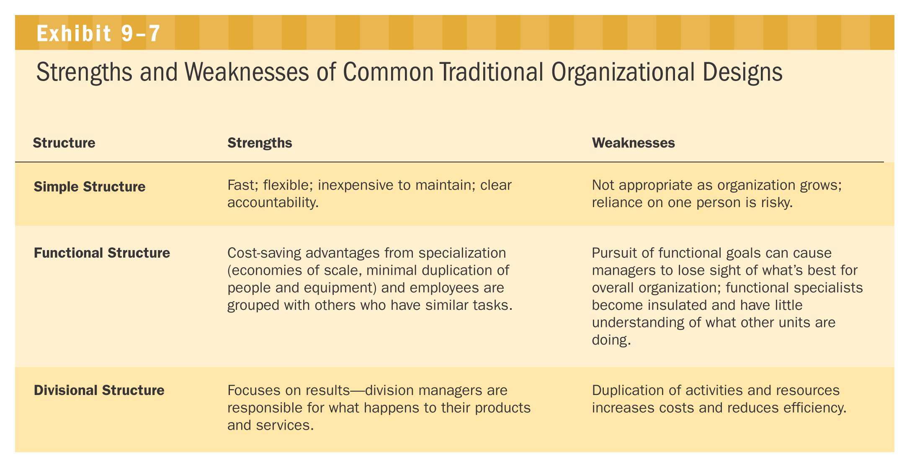
Strengths/Weaknesses of Common Traditional Organizational Designs
9-<number>
Chapter 9, Stephen P. Robbins, Mary Coulter, and Nancy Langton, Management, Ninth Canadian Edition
Copyright © 2009 Pearson Education Canada
Notes:
Exhibit 9.7 summarizes the strengths and weaknesses of each of the traditional organizational designs.

Slide 28
Contemporary Organizational Designs
Team Structures
  The entire organization is made up of work groups or self-managed teams of empowered employees
Matrix Structures
  Specialists for different functional departments are assigned to work on projects led by project managers
  Matrix participants have two managers
9-<number>
Chapter 9, Stephen P. Robbins, Mary Coulter, and Nancy Langton, Management, Ninth Canadian Edition
Copyright © 2009 Pearson Education Canada
Notes:
However, many of today’s organizations are finding that the traditional hierarchical organizational designs aren’t appropriate for the increasingly dynamic and complex environments they face.
1. Team structures. One of the newer concepts in organizational design is the team structure, which is an organizational structure made up of work groups or teams that perform the organization’s work.
2. Matrix and Project Structures. Another variation in organizational arrangements is based on the fact that many of today’s organizations deal with work activities of different time requirements and magnitude.
a. One of these arrangements is the matrix organization, which assigns specialists from different functional departments to work on one or more projects being led by project managers (see Exhibit 9.9).
b. Another of these designs is the project structure, which is a structure in which employees are permanently assigned to projects.

Slide 29
Contemporary Organizational Designs (cont.)
Project Structures
  Employees work continuously on projects, moving on to another project as each project is completed
Learning Organization
  An organization that has developed the capacity to continuously learn, adapt, and change through the practice of knowledge management by employees
9-<number>
Chapter 9, Stephen P. Robbins, Mary Coulter, and Nancy Langton, Management, Ninth Canadian Edition
Copyright © 2009 Pearson Education Canada
Notes:
However, many of today’s organizations are finding that the traditional hierarchical organizational designs aren’t appropriate for the increasingly dynamic and complex environments they face.
1. Team structures. One of the newer concepts in organizational design is the team structure, which is an organizational structure made up of work groups or teams that perform the organization’s work.
2. Matrix and Project Structures. Another variation in organizational arrangements is based on the fact that many of today’s organizations deal with work activities of different time requirements and magnitude.
a. One of these arrangements is the matrix organization, which assigns specialists from different functional departments to work on one or more projects being led by project managers (see Exhibit 9.9).
b. Another of these designs is the project structure, which is a structure in which employees are permanently assigned to projects.

Slide 30
Contemporary Organizational Designs (cont.)
Boundary-less Organization
    A flexible and an unstructured organizational design that is intended to break down external barriers between the organization and its customers and suppliers
    Removes internal (horizontal) boundaries:
      Eliminates the chain of command
      Has limitless spans of control
      Uses empowered teams rather than departments
    Eliminates external boundaries:
      Uses virtual, network, and modular organizational structures to get closer to stakeholders
9-<number>
Chapter 9, Stephen P. Robbins, Mary Coulter, and Nancy Langton, Management, Ninth Canadian Edition
Copyright © 2009 Pearson Education Canada
Notes:
Another approach to organizational design is the boundaryless organization, which describes an organization whose design is not defined by, or limited to, the horizontal, vertical, or external boundaries imposed by a predefined structure.

Slide 31
Examples of Removing Boundaries
Virtual Organization
  An organization that consists of a small core of full-time employees and that temporarily hires specialists to work on opportunities that arise
Network Organization
  A small core organization that outsources its major business functions (e.g., manufacturing) in order to concentrate on what it does best
Modular Organization
  A manufacturing organization that uses outside suppliers to provide product components for its final assembly operations
9-<number>
Chapter 9, Stephen P. Robbins, Mary Coulter, and Nancy Langton, Management, Ninth Canadian Edition
Copyright © 2009 Pearson Education Canada
Notes:
a. A virtual organization is one that consists of a small core of full-time employees and that temporarily hires outside specialists to work on opportunities that arise
b. A network organization is a small core organization that outsources major business functions
c. A modular organization is a manufacturing organization that uses outside suppliers to provide product components that are then assembled into final products.

Slide 32
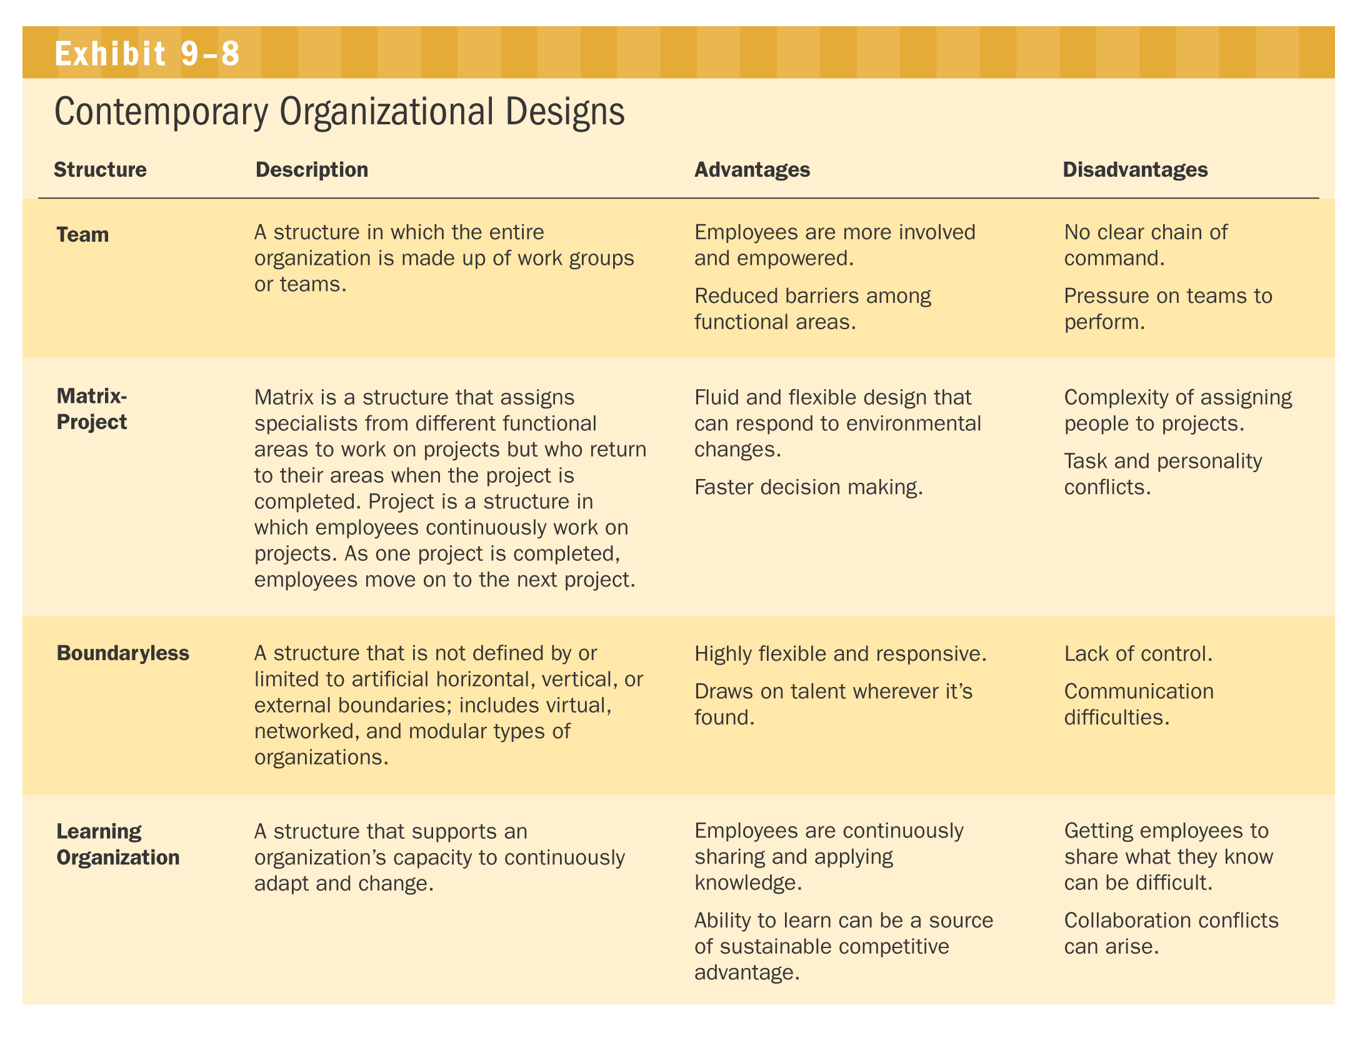
Contemporary Organizational Designs
Chapter 9, Stephen P. Robbins, Mary Coulter, and Nancy Langton, Management, Ninth Canadian Edition
Copyright © 2009 Pearson Education Canada
9-<number>
Notes:
Exhibit 9.8 summarizes the strengths and weaknesses of each of the contemporary organizational designs.

Slide 33
Exhibit 9.2 Functional Departmentalization
Plant Manager
Manager,
Manager,
Manager,
Manager,
Manager,
Engineering
Accounting
Manufacturing
Human Resources
Purchasing
+ Efficiencies from putting together similar specialties and people with common skills, knowledge, and orientations
+ Coordination within functional area
+ In-depth specialization
– Poor communication across functional areas
– Limited view of organizational goals
Return
Chapter 9, Stephen P. Robbins, Mary Coulter, and Nancy Langton, Management, Ninth Canadian Edition
Copyright © 2009 Pearson Education Canada
9-<number>
Notes:
Functional departmentalization is grouping jobs by functions performed.

Slide 34
Exhibit 9.2 Geographical Departmentalization
Vice President
for Sales
Sales Director,
Sales Director,
Sales Director,
Sales Director,
Western Region
Prairies Region
Central Region
Eastern Region
+ More effective and efficient handling of specific regional issues that arise
+ Serve needs of unique geographic markets better
– Duplication of functions
– Can feel isolated from other organizational areas
Return
Chapter 9, Stephen P. Robbins, Mary Coulter, and Nancy Langton, Management, Ninth Canadian Edition
Copyright © 2009 Pearson Education Canada
9-<number>
Notes:
Geographical departmentalization is grouping jobs on the basis of territory or geography.

Slide 35
Exhibit 9.2 Product Departmentalization
Bombardier, Ltd.
Mass Transit Sector
Recreational and
Utility Vehicles
Sector
Rail Products
Sector
Mass Transit
Division
Bombardier–Rotax
(Vienna)
Rail and Diesel
Products Division
Recreational
Products Division
Logistic
Equipment Division
Industrial
Equipment Division
Bombardier–Rotax
(Gunskirchen)
+ Allows specialization in particular products and services
+ Managers can become experts in their industry
+ Closer to customers
– Duplication of functions
– Limited view of organizational goals
Return
Source: Bombardier Annual Report.
Chapter 9, Stephen P. Robbins, Mary Coulter, and Nancy Langton, Management, Ninth Canadian Edition
Copyright © 2009 Pearson Education Canada
9-<number>
Notes:
Product departmentalization is grouping jobs by product line.

Slide 36
Exhibit 9.2 Process Departmentalization
Plant
Superintendent
Sawing
Department
Manager
Planing and Milling
Department Manager
Assembling
Department
Manager
Lacquering
and Sanding
Department
Manager
Finishing
Department
Manager
Inspection and
Shipping
Department
Manager
+ More efficient flow of work activities
– Can only be used with certain types of products
Return
Chapter 9, Stephen P. Robbins, Mary Coulter, and Nancy Langton, Management, Ninth Canadian Edition
Copyright © 2009 Pearson Education Canada
9-<number>
Notes:
Process departmentalization is grouping jobs on the basis of product or customer flow.

Slide 37
Exhibit 9.2 Customer Departmentalization
Director
of Sales
Manager,
Manager,
Manager,
Retail Accounts
Wholesale Accounts
Government Accounts
+ Customers’ needs and problems can be met by specialists
– Duplication of functions
– Limited view of organizational goals
Return
Chapter 9, Stephen P. Robbins, Mary Coulter, and Nancy Langton, Management, Ninth Canadian Edition
Copyright © 2009 Pearson Education Canada
9-<number>
Notes:
Customer departmentalization is grouping jobs on the basis of common customers.

Slide 38
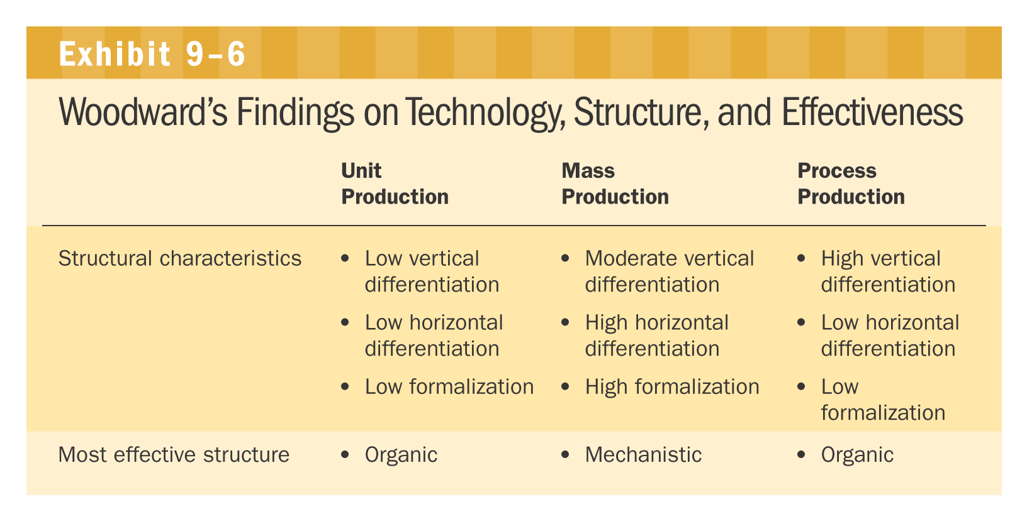
Exhibit 9.6 Woodward’s Findings on Technology, Structure, and Effectiveness
Return
Notes:
Woodward found in her study of these three groups that distinct relationships existed between these technologies, the subsequent structure of the organization, and the effectiveness of the organization. Exhibit 9.6 provides a summary of these findings.

